Slide 1
VITAMINS A & D
Name:
Course:
Date:
Instructor:

Slide 2
SOLUBILITY IN WATER
VITAMIN A
VITAMIN D
Vitamin A is not soluble in water but rather is a fat- soluble vitamin
Just like vitamin A, Vitamin D is not also soluble in water.

Slide 3
FUNCTIONS IN THE BODY
VITAMIN A
Vitamin D
Vision maintenance: Vitamin A is essential for maintaining the light-sensing cells in the eyes and for the formation of tear fluid.
Immune function: Vitamin A deficiency impairs immune function, increasing susceptibility to infections.
Body growth: Vitamin A is necessary for cell growth. Deficiency may slow or prevent growth in children.
Hair growth: It is also vital for hair growth. Deficiency leads to alopecia, or hair loss.
Reproductive function: Vitamin A maintains fertility and is vital for fetal development.
Bone maintenance: Vitamin D regulates the circulating levels of calcium and phosphorus, which are the most important minerals for bone growth and maintenance. It promotes the absorption of these minerals from the diet.
Immune system regulation: It also regulates and strengthens immune system function.

Slide 4
DAILY REFERENCE INTAKE
VITAMIN A
VITAMIN D
GENDER | AGE | RDA (IU / mcg) | UL (IU / mcg)
Women | 14–18 years | 2,333 / 700 | 9,333 / 2800
 | 19–70 years | 2,333 / 700 | 10,000 / 3000
Men | 14–18 years | 3,000 / 900 | 9,333 / 2800
 | 19–70 years | 3,000 / 900 | 10,000 / 3000
Age Group | RDA (IU / mcg) | UL (IU / mcg)
9–70 years | 600 / 15 | 4,000 / 100
70+ years | 800 / 20 | 4,000 / 100

Slide 5
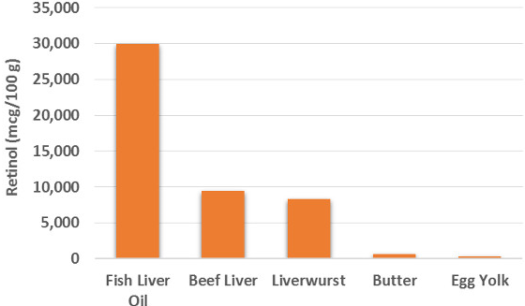
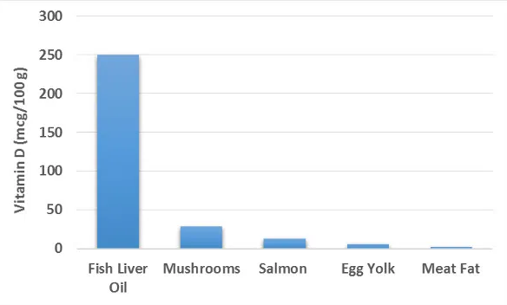
FOOD SOURCES
VITAMIN A
VITAMIN D

Slide 6
TOXICITY SIGNS/ SYMPTOMS
VITAMIN A
VITAMIN D
Overdosing on vitamin A leads to an adverse condition known as hypervitaminosis A.
The main symptoms and consequences of toxicity include fatigue, headache, irritability, stomach pain, joint pain, lack of appetite, vomiting, blurred vision, skin problems and inflammation in the mouth and eyes.
It is advised to avoid exceeding the upper limit for intake, which is 10,000 IU (900 mcg) per day for adults.
Vitamin D toxicity is very rare.
The main consequence of toxicity is hypercalcemia, a condition characterized by excessive amounts of calcium in the blood.
Symptoms include headache, nausea, lack of appetite, weight loss, fatigue, kidney and heart damage, high blood pressure and fetal abnormalities, to name a few.
It is advised to avoid exceeding the upper limit of vitamin D intake, which is 4,000 IU per day for adults.

Slide 7
DEFICIENCY SIGNS/ SYMPTOMS
VITAMIN A
VITAMIN D
Night blindness: It is the most common symptom of early deficiency.
Dry eyes: Severe deficiency may cause xerophthalmia, a condition characterized by dry eyes caused by reduced tear fluid formation.
Blindness: Serious vitamin A deficiency may lead to total blindness. In fact, it is among the most common preventable causes of blindness in the world.
Hair loss: If you are vitamin A deficient, you may start to lose your hair.
Skin problems: Deficiency leads to a skin condition known as hyperkeratosis or goose flesh.
Poor immune function: Poor vitamin A status or deficiency makes people prone to infections.
The most well-known consequences of vitamin D deficiency include soft bones, weak muscles and an increased risk of bone fractures. This condition is called osteomalacia in adults and rickets in children.
Vitamin D deficiency is also associated with poor immune function, an increased susceptibility to infections and autoimmune diseases.
Other signs of deficiency include fatigue, depression, hair loss and impaired wound healing.
Low vitamin D levels leads increased risk of dying from cancer and an elevated risk of heart attacks.

